Slide 1
Partnering on Your Journey to Zero

Slide 2
WILL EDWARDS director of channels
Introduction

Slide 3
About us
We help customers code, mark, address, decorate, or personalise their products in- or near-line, in all production conditions, adding fully variable alphanumeric text, graphics, and machine-readable codes to products or packaging in real time.
Worldwide sales and operations
Founded in 1978
Brother Group company
HQ in Bar Hill, Cambridge, England
3,000+ employees worldwide
Bought
for over £1bn in 2015

Slide 4
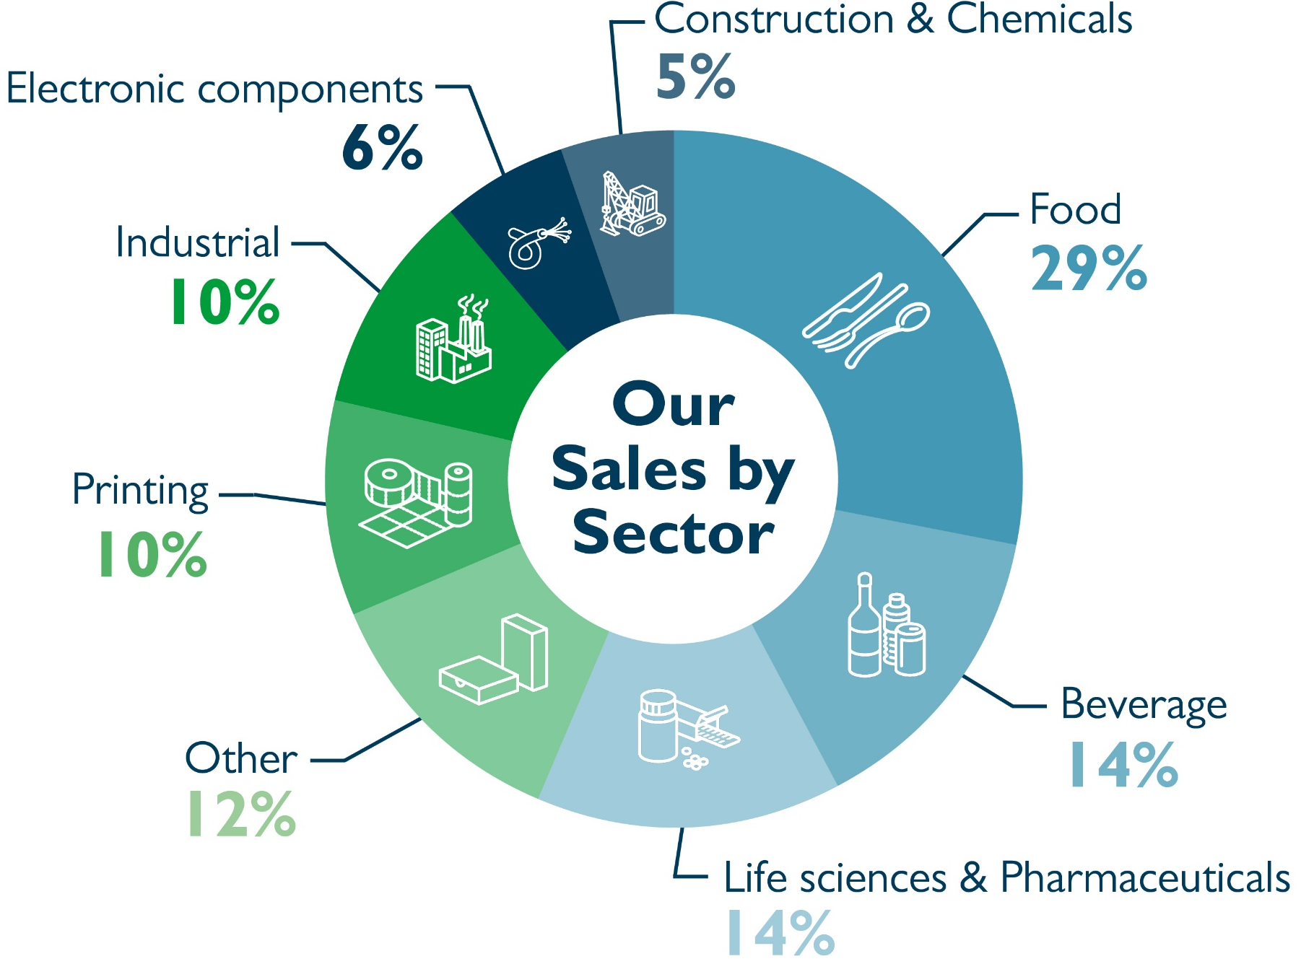

Slide 5
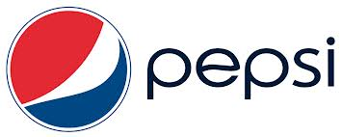
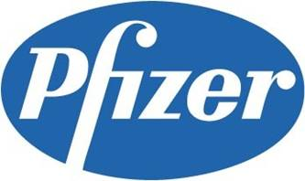
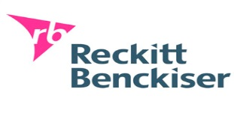
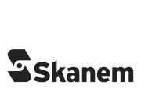
Example customers
Beverage
Food
Printing
Pharmaceutical

Slide 6
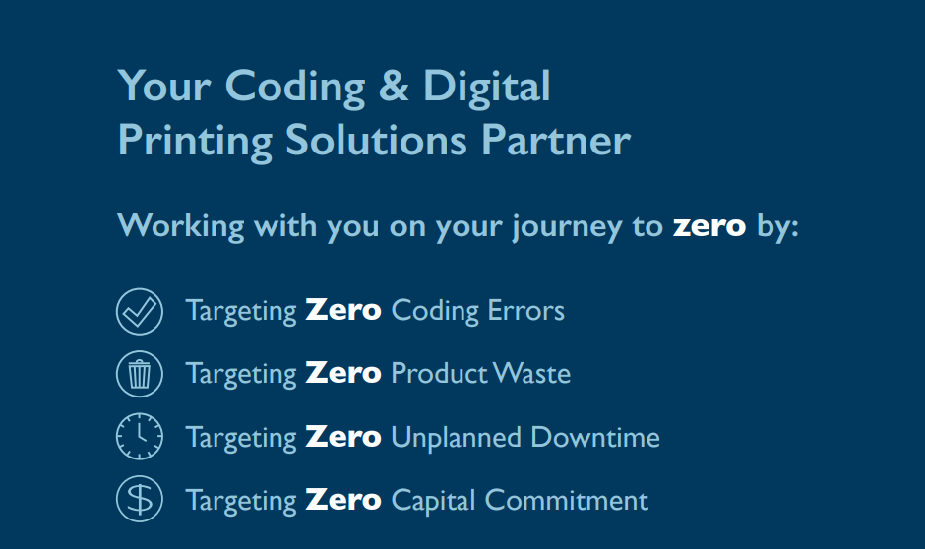
The main themes
Customer challenges
- Supporting consumer choice
- Shifting to remote working and monitoring
- Driving sustainability
- Financial flexibility to deliver outcomes

Slide 7
Introducing the topics and speakers
How to Identify and Reduce ‘Hidden’ Wastes
Jeremy Jones, Global Marketing Director, Domino
The Path to Zero Unplanned Downtime & Waste
Adem Kulauzovic, Director of Automation, Domino
New Sustainable Flexible Film Materials: What are the Best Coding Solutions?
Lutz Altmann, Senior Laser Application Specialist, Domino
Amaia Cowan, Business Development Manager, EMEA Futamura
Kerstin Dietze, Key Account Manager, Packaging Solutions, Sappi Europe

Slide 8
Jeremy jones Global marketing director
The Journey to Zero: How to Identify and Reduce ‘Hidden’ Wastes

Slide 9
We all know about waste…

Slide 10
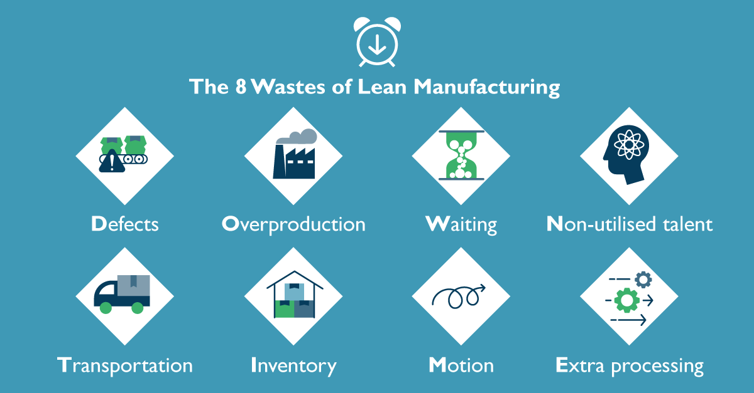

Slide 11
So if we know WHY it happens,
HOW does it still happen?

Slide 12
We often can’t spot things hiding in plain sight

Slide 13
Or we don’t realise what we’re looking at…

Slide 14
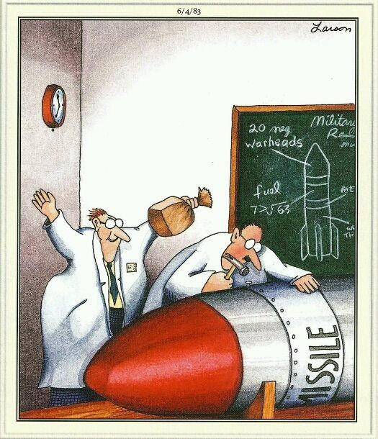
And sometimes, we simply underestimate the impact of our errors…*
* Credit to Gary Larson, cartoon genius

Slide 15
My twin objectives for this event:
Highlight ‘hidden’ areas of waste risk
Help everyone to recognise their impact

Slide 16
Revealing the ‘hidden’ wastes
Manual Data Entry
Product Reliability Issues
Service Delays
Lack of Integrated Data
Manual Inspection

Slide 17
What does it mean for manufacturers?

Slide 18
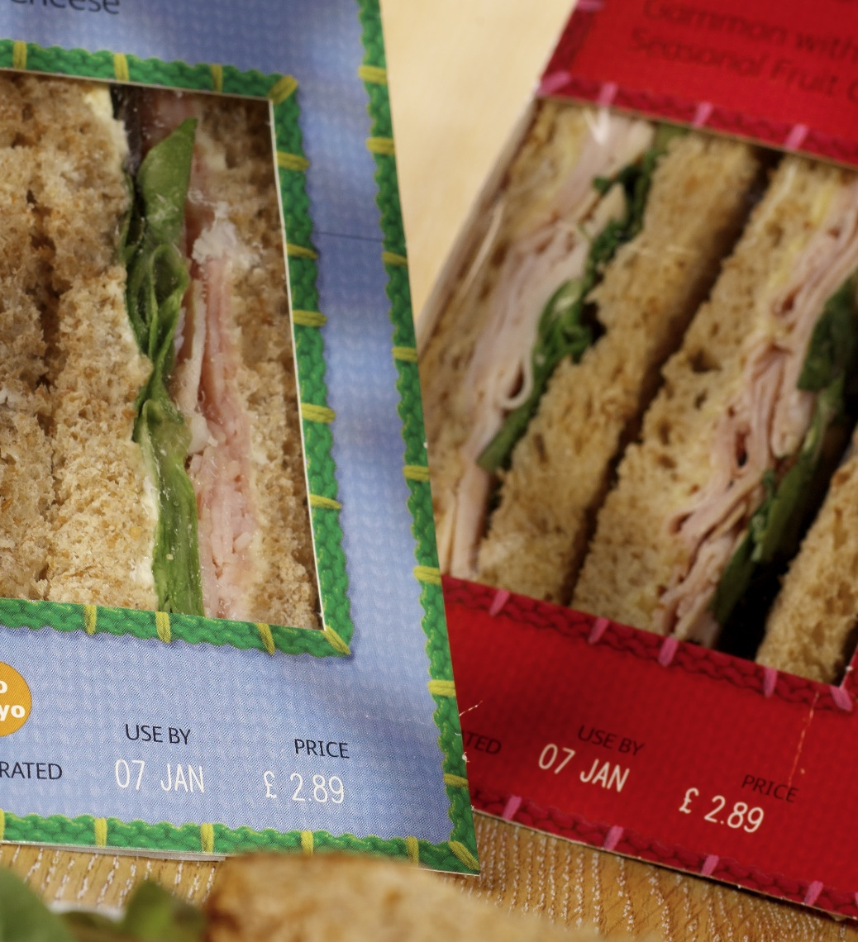
Manual Data Entry
Company
Sandwich manufacturer with a changing mix of dozens of SKUs.
Waste
A full-time job maintaining hundreds of individual labels.
Further issues
Risk of updates errors to ingredients, allergens etc. due to individual labels.
Simple solution
Domino Automation simplified this list down to just a handful of templates, automatically populated for each product, and ensuring accuracy of data.

Slide 19
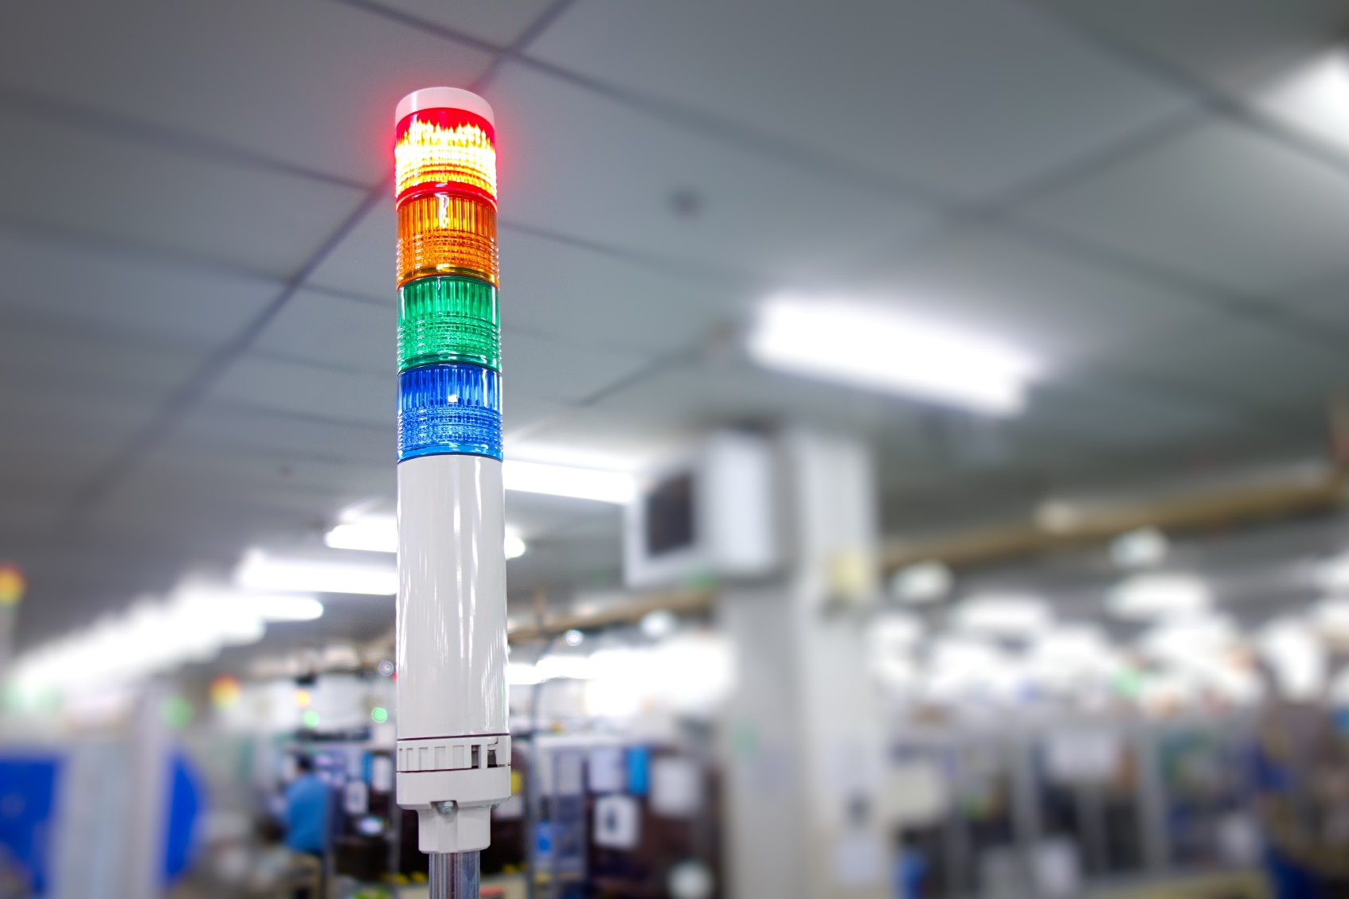
Product Reliability Issues
Company
Food manufacturer using cheaper TTO machine and compatible ribbons.
Waste
Regular breakdowns through ribbon snaps (15/month) generated 28 hrs of downtime/printer/year, totalling €29k/printer of lost revenue.
Further issues
The high need for monitoring and manual intervention meant someone needed to be on hand at all times.
Simple solution
Switching to a new Domino TTO solution with original ribbons eradicated ribbons snaps and dramatically reduced the main cause of downtime, saving €28k per printer. It also significantly reduced the requirement for operator time.

Slide 20
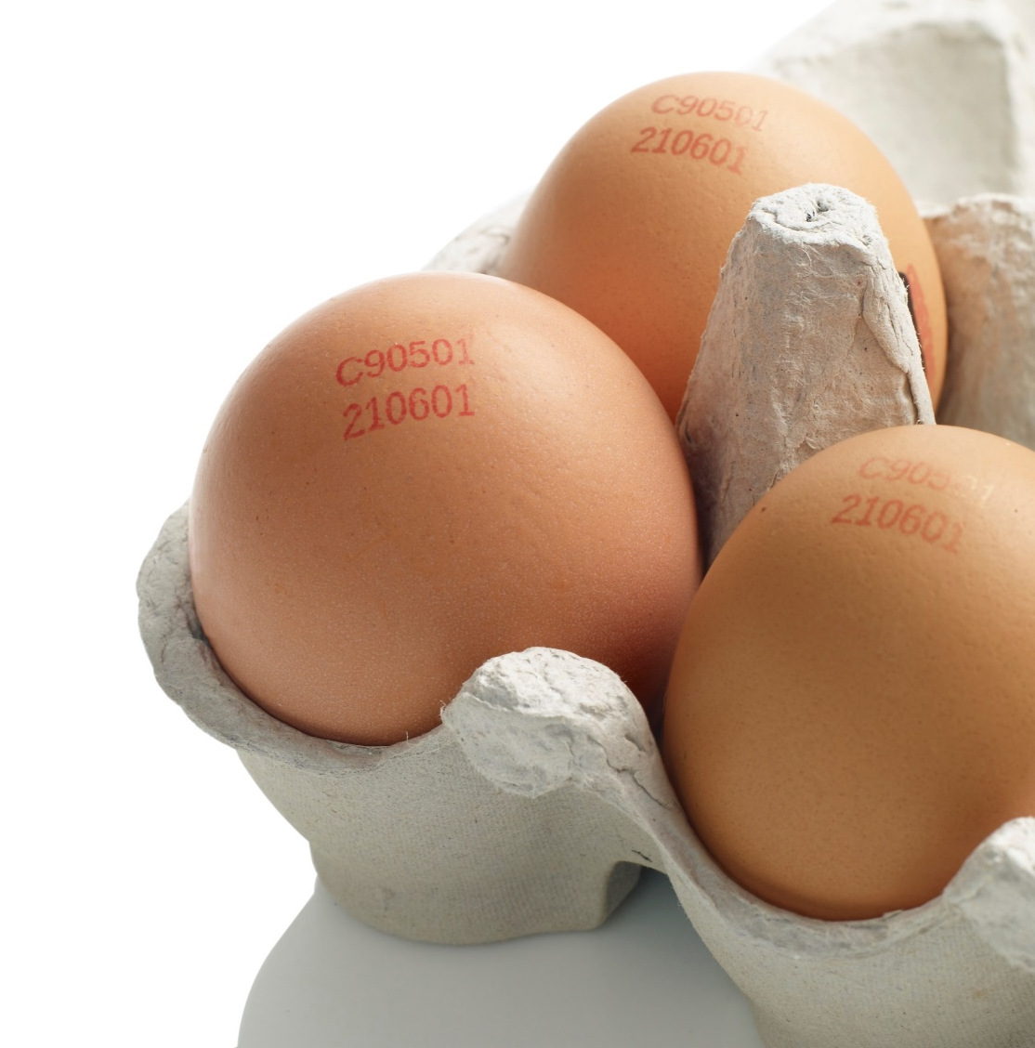
Service Delays
Company
Egg producer had unidentified error with Domino printer.
Waste
Highly perishable product, backing up and needing coding.
Further issues
The machine appeared to have triggered multiple alerts which made phone-based diagnostics challenging and would mean a wait for a service engineer.
Simple solution
Using Domino SafeGuard AR’s remote assistance and Domino Cloud data allowed the Technical Helpdesk Engineer to have much greater visibility of the system and allowed a full diagnostic, reboot, and recalibration without the need to send a service engineer.
(p.s. in 76% of cases, SafeGuard AR has removed the delay in waiting for a Service Engineer visit)

Slide 21
Manual Inspection
Company
Pharma manufacturer supplying products globally.
Waste
Sent a shipping container full of products 17,000 miles to Asia. The customer discovered the products were labelled with another APAC country’s data.
Further issues
The manufacturer had to pay to ship the same product 17,000 miles home, and was also fined cents per box, meaning added costs of >€92k.
Simple solution
Automated data labelling with Domino Automation, and auto-verification via R-Series vision inspection system ensures the right info on the right product for the right batch.

Slide 22
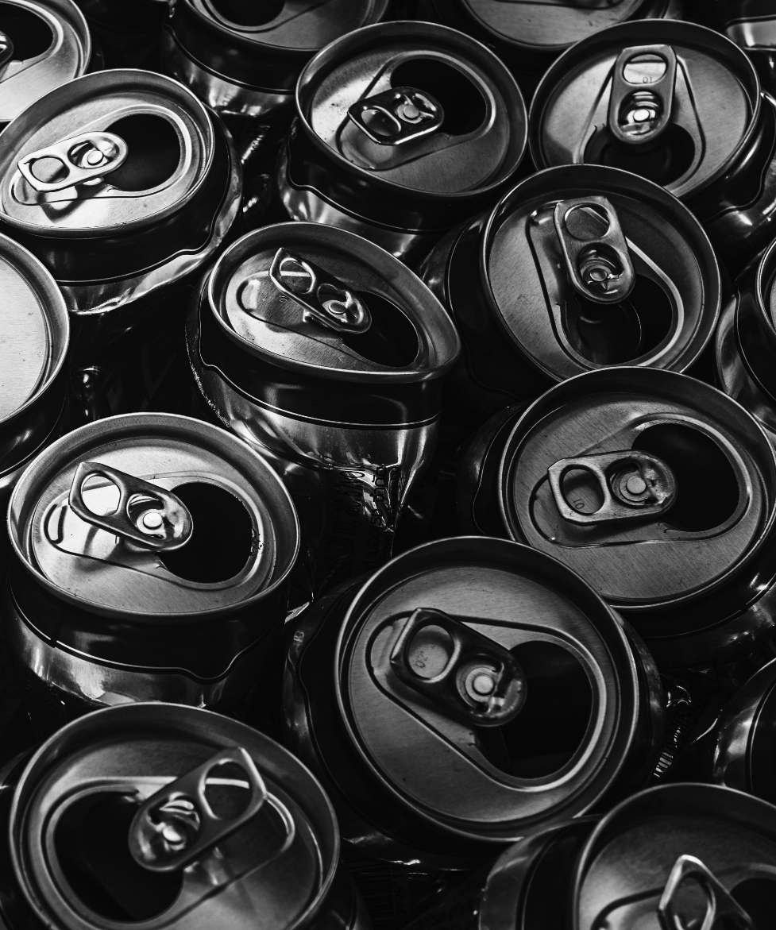
Lack of Integrated Data
Company Beverage canning company, switching to Domino CIJ printers.
Waste Unexpectedly high ink usage. Customer believed the printers to be less effective than expected.
Simple solution
Domino’s integrated data allowed us to show:
the cans were being coded correctly, but
the pallet numbers were too low (by about half!)
The customer had a faulty QA system that was rejecting almost every other can, believing it was empty…and…
The person whose job it was to empty the dump bin of rejected cans didn’t think it was his job to notify…
The QA system was fixed and the customer saw the performance benefit of the printer AND the data.

Slide 23
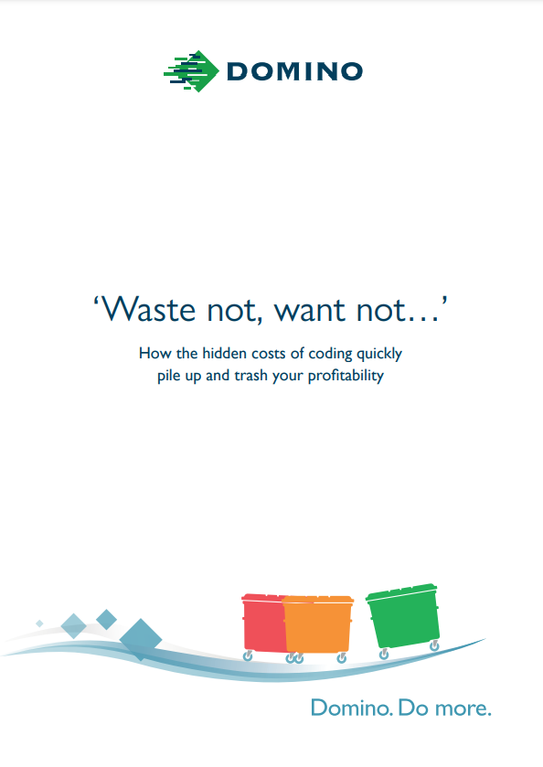
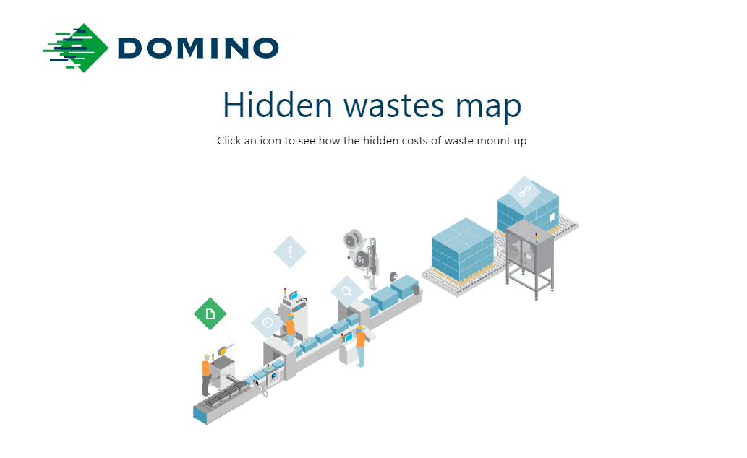
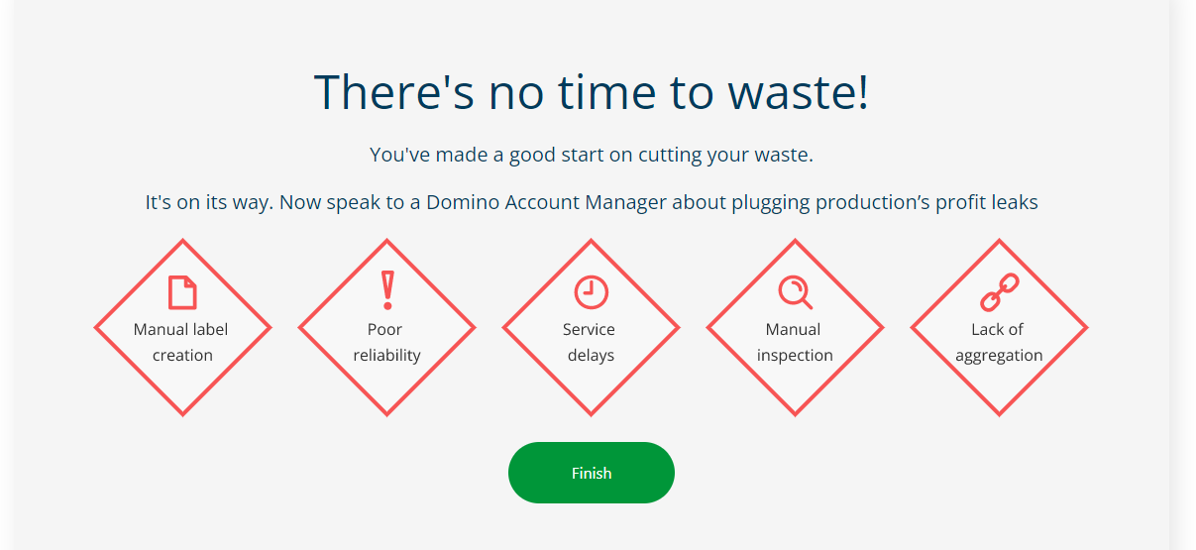
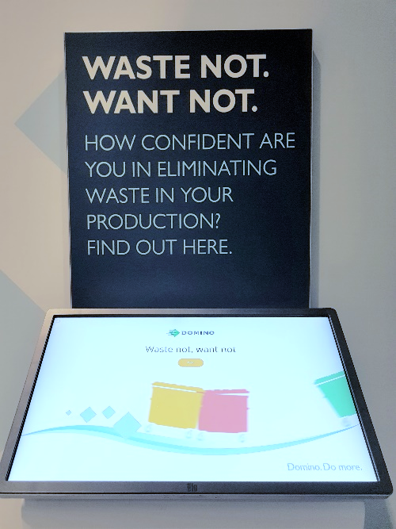
Find out more with our Waste Calculator
A fun way to showcase hidden costs and their impact
Features a simplified production line view
Highlights the 5 key points of waste
Users can get a generic cost report or one customised to their production costs
Forms the basis for a business case conversation

Slide 24
Adem Kulauzovic Global Director of Automation
The Path to Zero Unplanned Downtime & Waste
Notes:
Today’s Manufacturing facilities are getting larger and larger, and with that growth come more and more challenges of making sure product is being produced properly, packages labeled correctly, in a accurate and efficient manner.

Slide 25
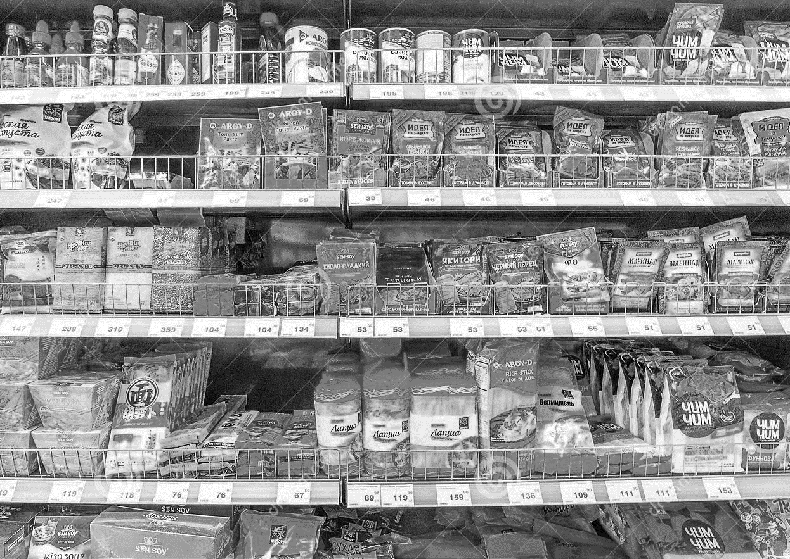
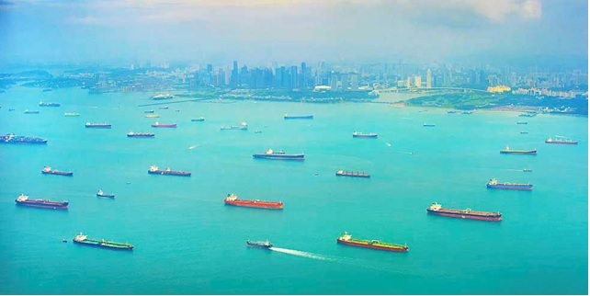
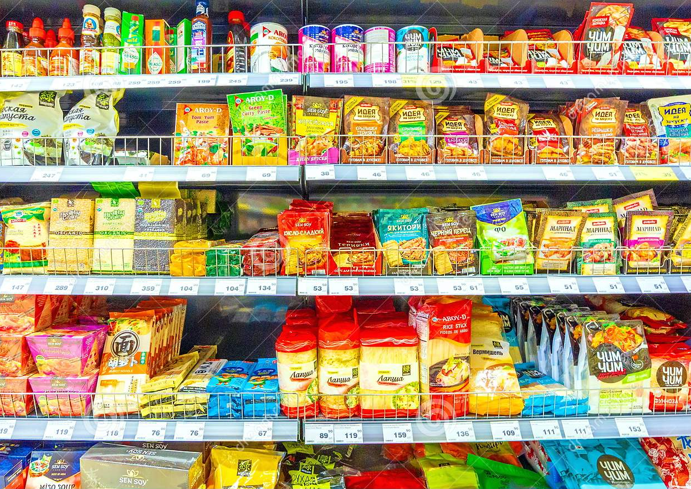
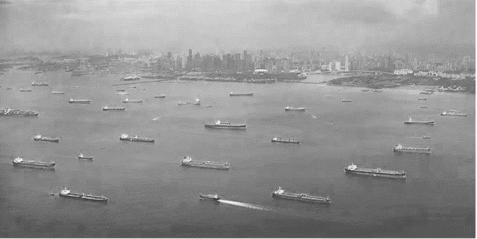

Slide 26
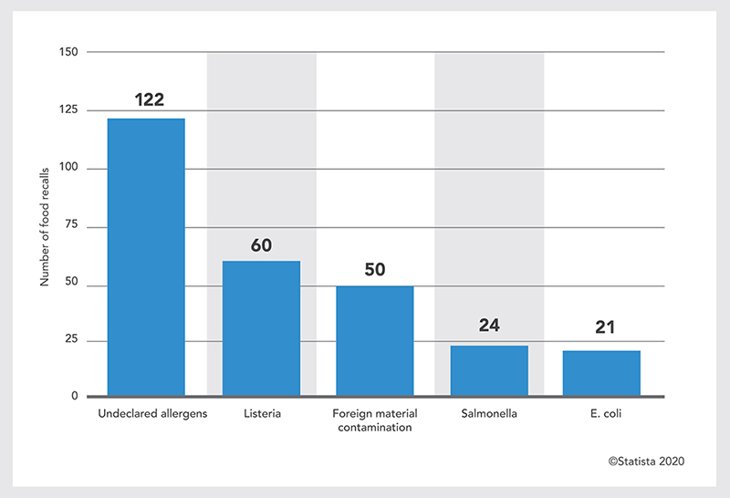
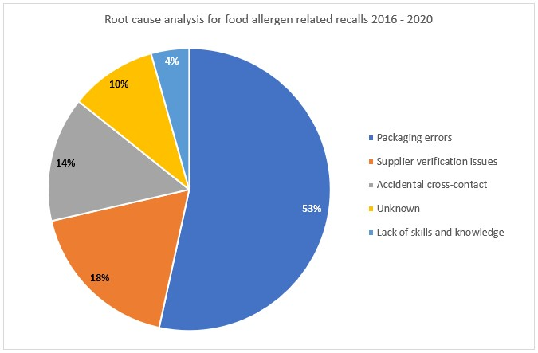
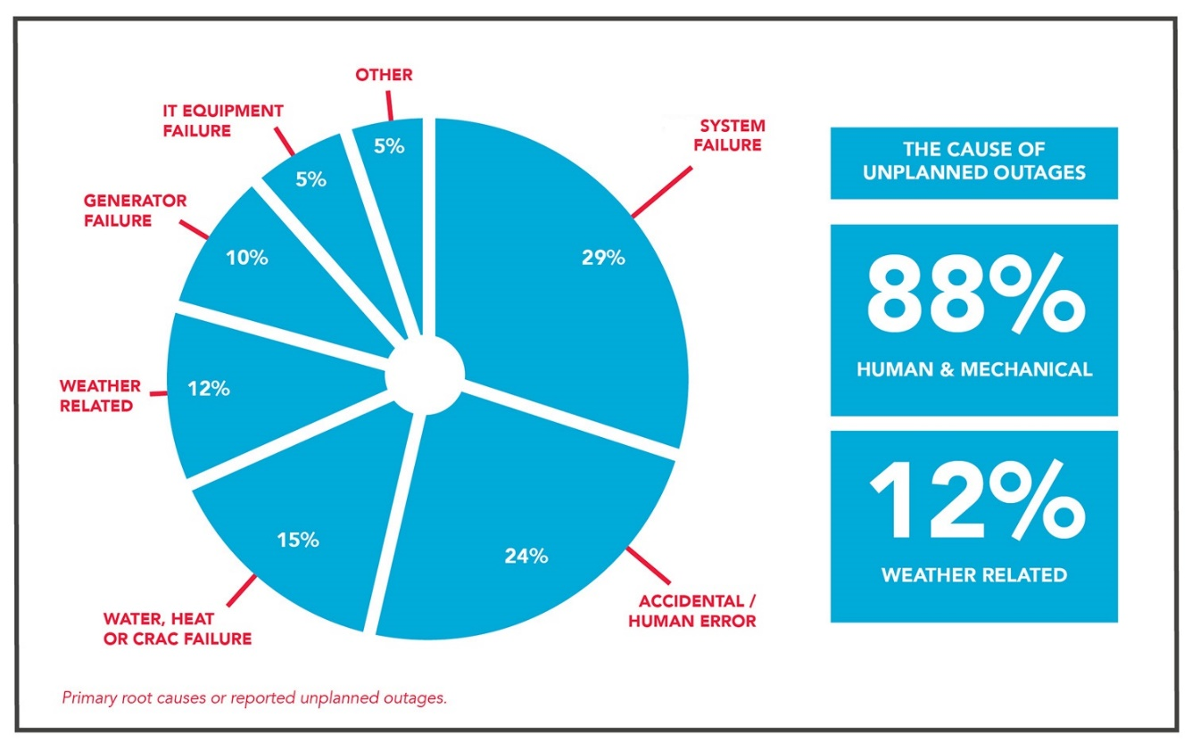
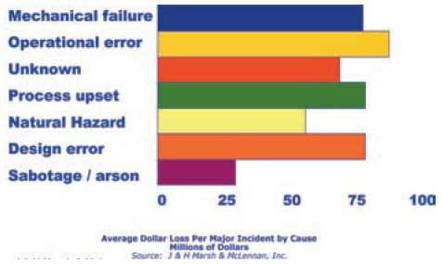
Labelling errors top recall issue 4 years in a row

Slide 27
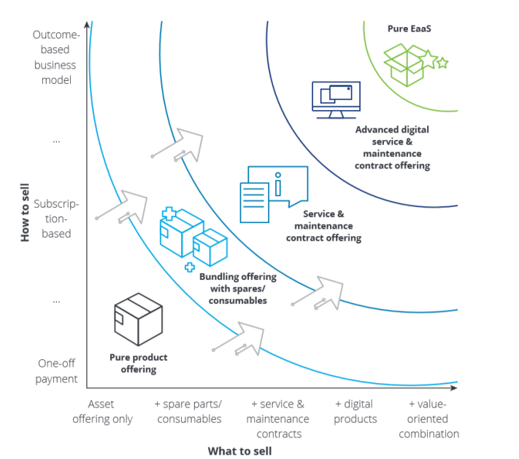
Customers are looking for…
Access Everywhere
Expanded Collaboration
On-Demand Scaling
Improved Lifecycle Management
CapEx to OpEx Shift
The global pandemic has accelerated remote working
Remote monitoring of factory floors has increased along with thin client-based software
Distributed teams and workforce, requires improved collaboration
Convergence of OT/IT is one of the main challenges
Business efficiency requires flexible and scalable capacity
Risk mitigation requires hardware and software to stay up to date
Looking for manufacturers to partner with and share responsibility
Evolution from “buying stuff” to “paying for outcomes”
ROI is now IIE (increase in efficiency)

Slide 28
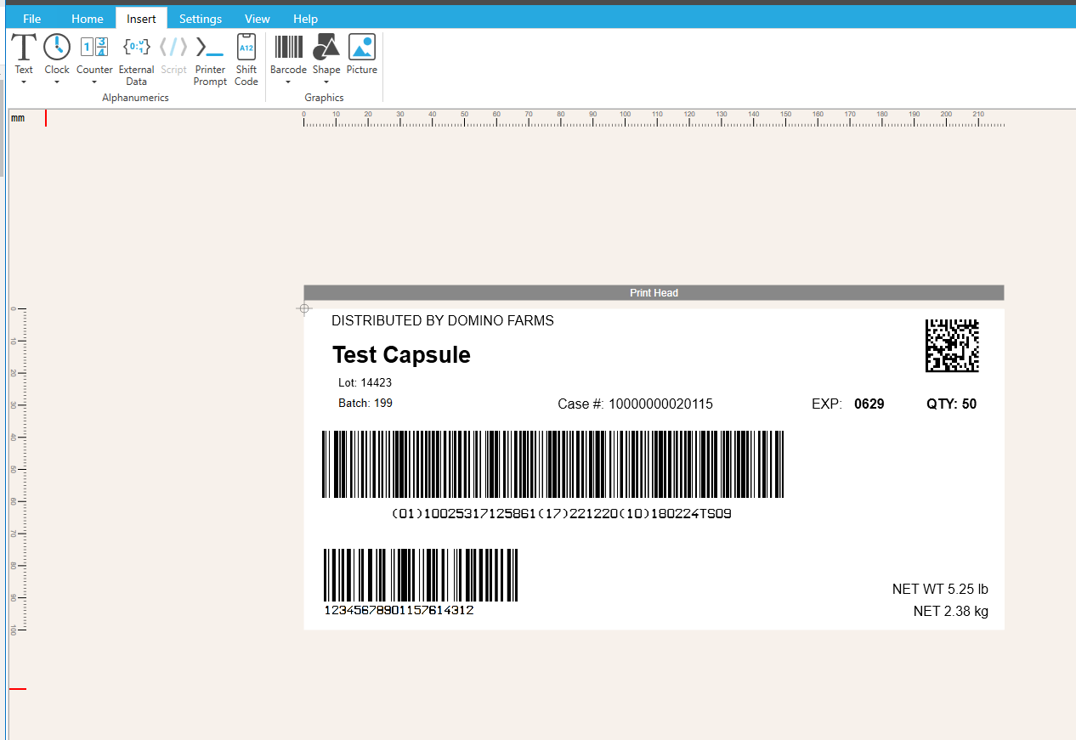
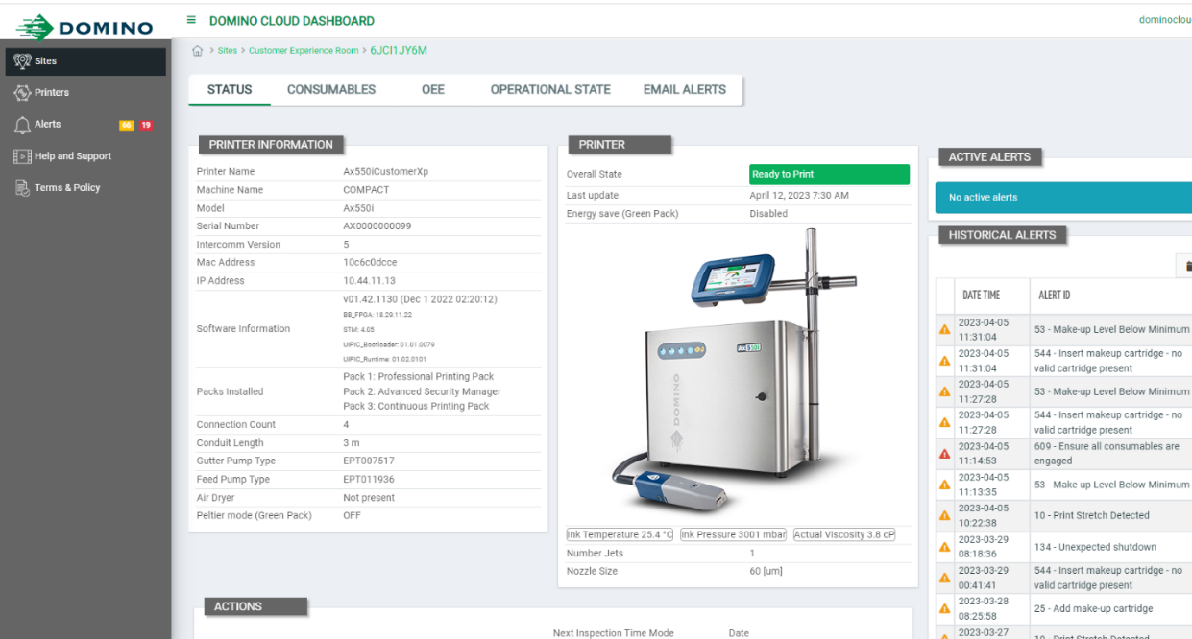
Automation for error-free
product marking and validation

Slide 29
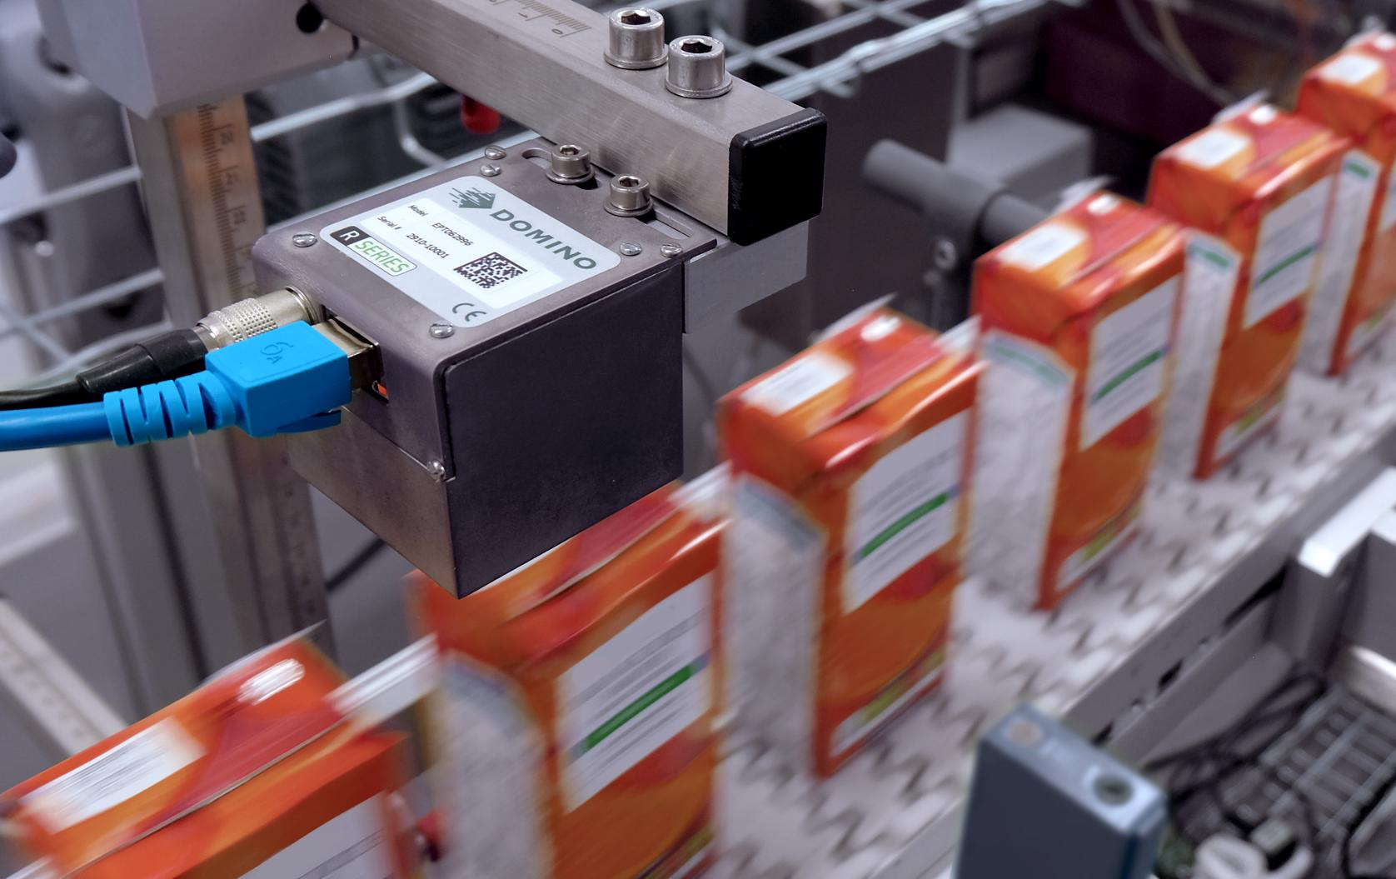
Automation for error-free product marking and validation

Slide 30
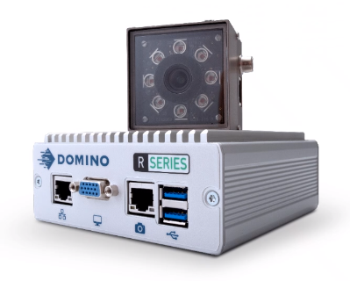
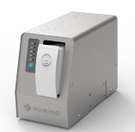
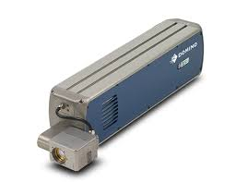
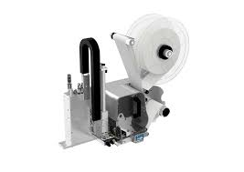
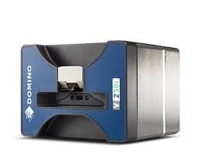
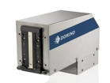
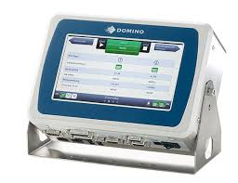
Core and beyond…
Beyond Printer
Advanced Services
Coding as a Service
Outcome-based services e.g. Guaranteed code on every product
Beyond Printer
Integration & Data
Beyond Printer
Business Products
& Contracts
Finance Services
SafeGuard
SafeSupply
Increasing Value to Customer + Domino
Core
New
Applications
& Substrates
TIJ Variants
New Inks
+UV
R-Series
Core
Replacement Printers / Inks

Slide 31
Lutz Altmann Senior Laser Application Specialist
New Sustainable Flexible Film Materials: What are the Best Coding Solutions?

Slide 32
Code on sustainable flexible materials
What are the coding requirements for sustainable packing materials from the market?
Can we securely code on sustainable flexible materials?
How did Domino select the appropriate solution?
How did Domino ensure that the laser did not compromise the film’s integrity?

Slide 33
Collaboration
Renewable, compostable film range
Amaia Cowan, Business Development Manager

Slide 34
NatureFlex™ a perfect fit for the circular economy
Eucalyptus Trees
Cellulose film
A “transparent paper”
Principal raw material is wood pulp from managed forestry sources only
Composting
Pulp Bales
Retail/Consumer Packaging
Film Production
Coating Technologies

Slide 35
Certification
Independent testing & certification wherever relevant & possible
Europe
Industrial Composting
USA Industrial Composting
Europe Home Composting
Australian
Home
Composting
Global Forestry Management
Japan
Biomass
Mark

Slide 36
Applications

Slide 37
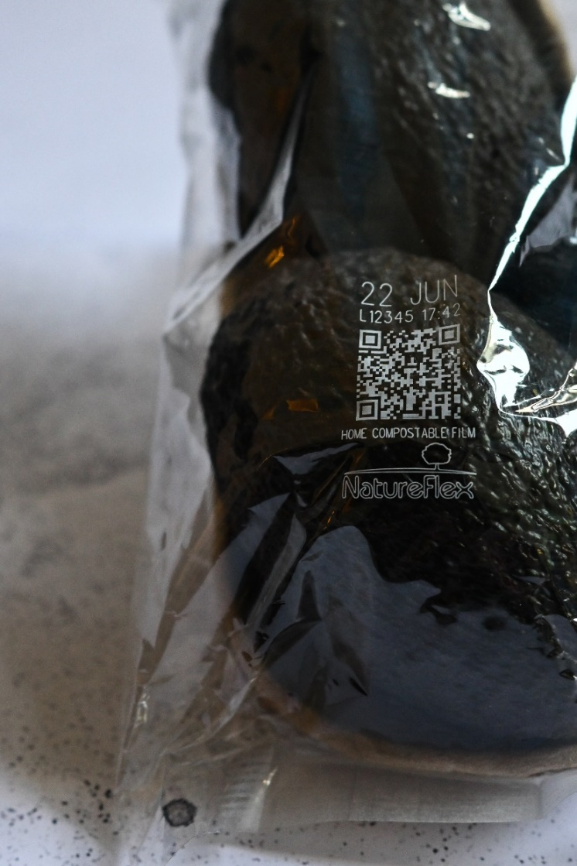
Collaboration with Domino Printing Sciences
The challenge
Increased desired to include a simple message on the packaging
Information such as:
End-of-life options
Certification
Traceability
Additional codes
Whilst avoiding the printing stage

Slide 38
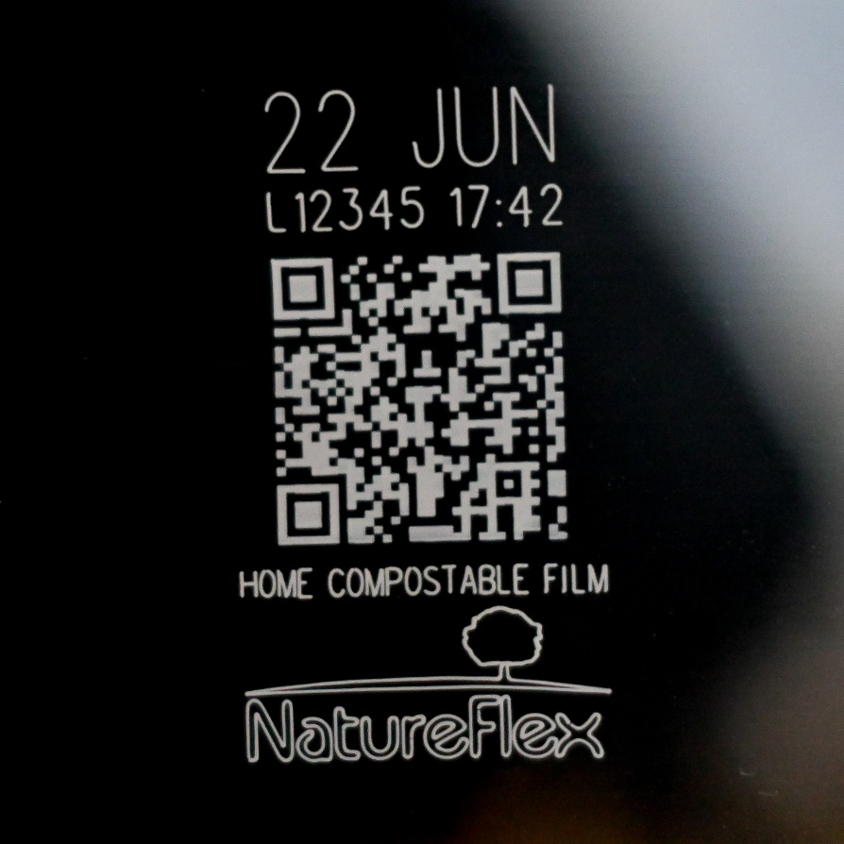
Collaboration with Domino Printing Sciences
Results
Domino suitability testing of NatureFlex™ films for coding
Confirmation that a clean, crisp, white code can be achieved with the D-Series CO2 lasers
Achieved at high speed
Without affecting the film properties (the chemical composition or barrier properties)

Slide 39
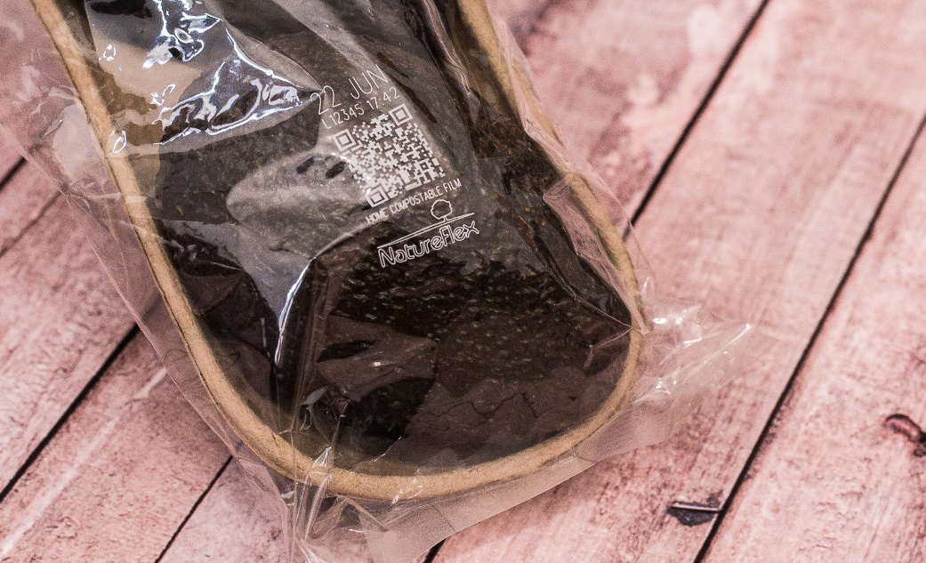
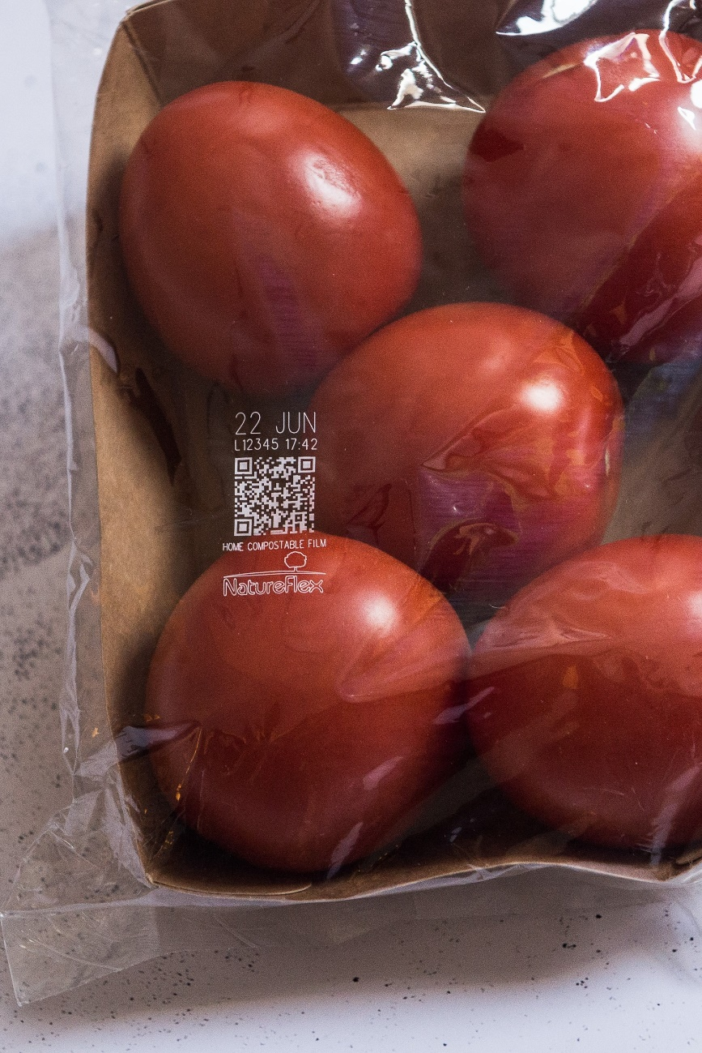
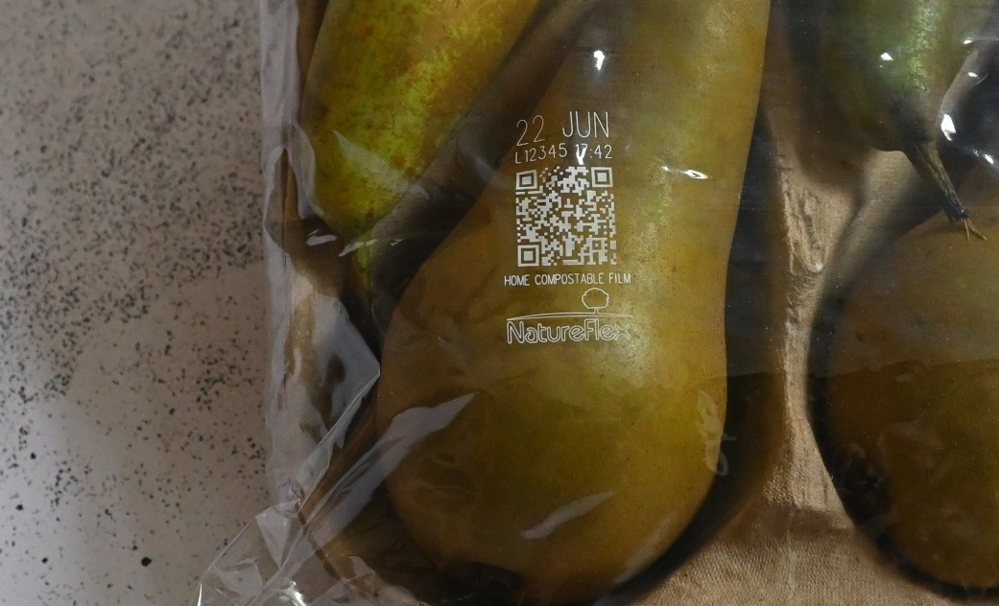
The result

Slide 40
Thank you!
Visit us
Hall 9 F13

Slide 41
Domino & Sappi Collaboration
on Functional
Paper
Packaging
Kerstin Dietze,
Key Account Manager Packaging Solutions
Supporting brand owners to ensure damage free, excellent laser coding quality on barrier papers for flexible packaging

Slide 42
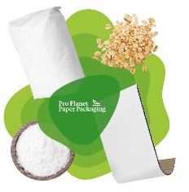
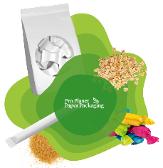
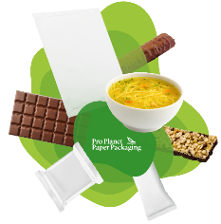
Sappi is the innovation leader in functional papers for flexible packaging applications
Paper mono materials for flexible packaging
Widest functional paper range in the market
Print surfaces are available in gloss, silk, and nature
Excellent barrier and print results
All papers recyclable with the paper waste stream
Wide range from low- and medium- to high-barrier papers
Guard Nature MS
Guard Silk MS
Guard Nature M
Guard Silk M
Seal Silk
Seal Silk G
Seal Gloss Light
Seal Nature GR
Guard Twist
Guard Gloss OHG
Guard Nature OHG
AvantGuard Gloss S
AvantGuard Nature S

Slide 43
The substrates: recyclable flexible packaging papers with integrated barriers
The key target:
Transformation from non-recyclable multi-layer films to recyclable high-barrier mono-papers
Generation 1
Generation 2-3
Generation 4
Paper/PET/OPP
Print coating
Print coating
Print coating
Adhesive (Tie layer)
Paper
Paper
Paper
Barrier layer (Alu/PET)
Polymer-based high-barrier coating
Polymer-based high-barrier coating
>80% renewable sources
Continuous further development on product portfolio
Adhesive (Tie layer)
Sealant layer (PE/PP/Ionomer)
2015-2020
2020-2025
2025 and beyond

Slide 44
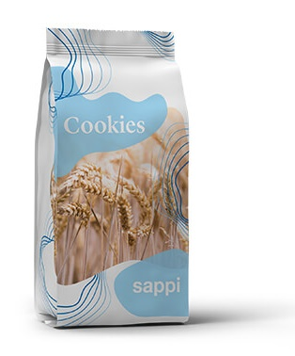
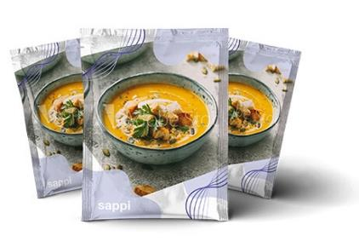
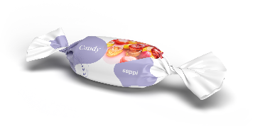
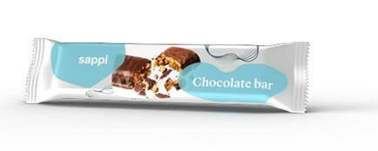
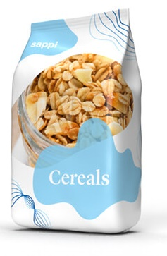
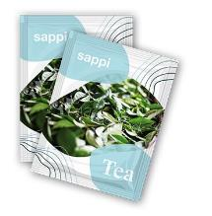
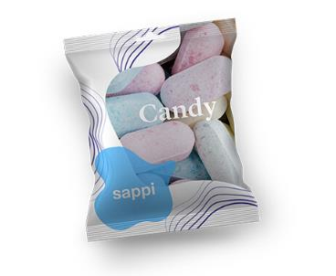
Suitable for most of flexible packaging formats and applications
Block bottom bags for dried ingredients such as sugar and pasta
Flow wrappers for snacks, chocolate, and confectionery
Pouches for processed foods
Notes:
As you can probably imagine, the transition from a thin plastic film structure to a comparably thicker and stiffer paper substrate rises a lot of questions and concerns at the customer, when starting such a journey, like shelf life performance and runability on packing lines.
One of the adressed questions was regarding suitably coding systems for paper.

Slide 45
The challenge
Achieve a clean, crisp code without affecting the barrier properties.
Application of readable 2D codes to facilitate data sharing and traceability.
best before and use by dates,
as well as
standard batch and product codes.
Notes:
2 Coding Systems: Inkjet & Laser (50:50 market share)
Inkjet is not critical on paper → look into laser coding, being a more invasive technology
Amongst Laser Coders, CO2 Lasers are the most common at our customers
In addition there is a strong trend to replace 1D-EAN Codes by 2D-Codes (product codes, batch numbers, best before dates, product traceability, nutrition information, ….) → test with text, logo and 2D Codes
The challenge: achieve a clean crisp code, providing excellent readability, without damaging the barrier properties of the paper substrate.
Ambition: Facitlitate use of existing CO2 laser at manufacturers when switching from mulitylayer film substrates to barrier papers
https://www.neue-verpackung.de/markt/2d-code-fuer-passgenaue-detaillierte-informationen-697.html?emi=OB9x90MtAq&utm_campaign=Newsletter+neue+verpackung+20%2F04%2F23-NL_NV&utm_source=nv_newsletter&utm_medium=email&sc_src=email_9117693&sc_lid=604113311&sc_uid=OB9x90MtAq&sc_llid=1673&sc_eh=8d459c9d4b25878d1

Slide 46
The collaboration
CO2 lasers are the most suited laser application for paper packaging
Measuring of the response rate via FT-IR spectroscopic analysis to identify the ideal laser wavelength
The graph above shows the response of the substrate to Domino’s blue, black, and red tube CO2 lasers, with the blue tube laser presenting a slightly more favorable absorption rate. Further suitability testing identified the D320i blue tube laser as the optimal solution.
In code quality testing, the D320i created crisp, clear codes on the barrier papers, for simple messages, such as best before dates and batch codes, as well as more complex designs, including graphics and scannable 2D codes.
Notes:
In fact CO2 lasers are not only have the highest market share, they are also the most suited laser technology for paper packaging.
The Domino Team and Sappi Team met at the Domino lab and together tested a full range of barrier papers from Sappi to determine the ideal laser wavelength with FT-IR Spectroscopy

Slide 47
The solution
Checking of laser engraving depth via 3D imaging
Excellent removal just of the top layer without engraving too deep into the material’s surface to create an indelible code.
Measurements of oxygen and water vapour barriers on uncoded and coded barrier papers shows excellent results.
Notes:
With the help of 3D imaging the Domino team has checked the laser engraving depth.
That was important to make sure that
just the top layer has been removed without engraving too dep int the surface
The code is indelible and well readable
Sappi has measured the oxygen and water vapour barrier transmission rates on uncoded and coded samples.
As you can see on the graphs, there are no signifiatn differences between uncoded and coded smaples. The minor difference are within the measuring tolerance.
The conclusion: existing CO2 lasers can be used with Sappi barrier papers. The quality of the coding is excellent, without negative impact on the barrier properties. And very important for the customer: no capex invest in any new coding systems or upgrading is necessary.

Slide 48
“We were very impressed with the results of the barrier testing. This, combined with the quality and clarity of the codes, make Domino’s D-series a good choice for Sappi’s customers.”
Mike Zywietz,
Product Application Engineer @ Sappi

Slide 49
Let’s recap
CO2 laser have the highest market share in laser coding applications
A replacement with different technology would potentially mean high capex investment
Trend to 2D codes → require high laser intensity → higher threat of damaging the paper
Optimal wavelength has been identified
Key question answered: can Sappi Barrier Papers be coded with CO2 lasers without a negative impact on barrier properties – yes!
Highest quality codes (even 2D codes) could be achieved without scarifying the barrier properties of the substrate.
→ Brand owners can use their existing CO2 lasers when switching from non-recyclable multilayer packaging materials to recyclable paper packaging solutions without capex investment into new coding equipment.

Slide 50
Thank you! Visit us! Hall 8A B35 kerstin.dietze@sappi.com

Slide 51
Questions?

